Slide 1

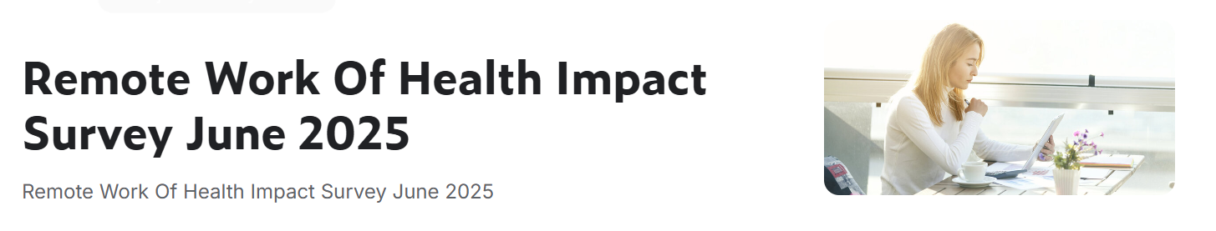

Slide 2
Hours Per Week Analysis
Standardization
Standard Working Hours Calculation: 5 days Working 8 hrs. in a day and 5 days a week totals 40 hrs.
Weekly wise:
The avg. age group of youth people worked more than adults.
Gender-wise:
Non-binary worked more than other genders.
Region wise :
Africa, Oceania, and South America worked more extra hours than the standard working hours.
Work Arrangement:
Onsite platform people worked compare with hybrid and remote

Slide 3
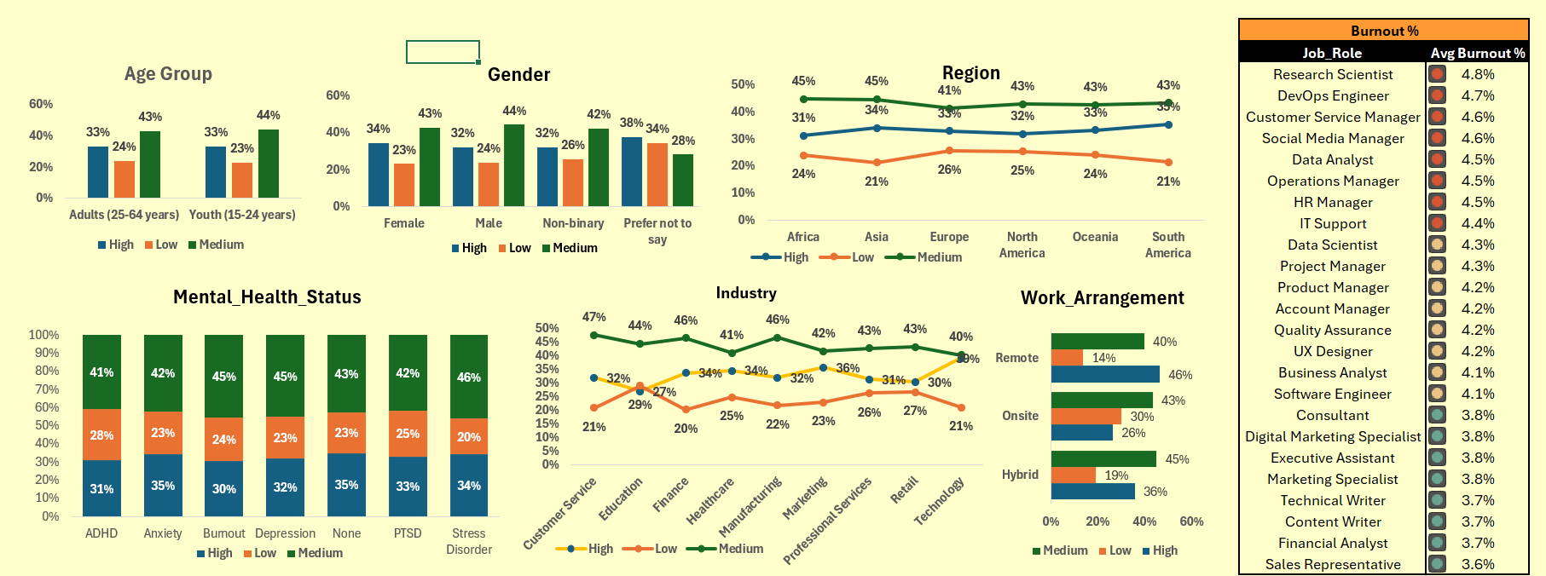
Burnout Analysis
Key Findings:
Medium burnout level is the highest alert across age + gender
High burnout % peaks in South America & Asia. Medium burnout leads in Asia & Africa
Anxiety is highest in mental health issues; Stress leads at medium level
Industry: Marketing shows highest burnout. Customer Service, Manufacturing & Finance lead at medium level
Work mode: Remote employees report more burnout
Job role: Research Scientist has highest avg burnout at 4.8%, followed by DevOps Engineer & Customer Service Manager

Slide 4
Physical Health Issues
Key Findings:
Eye strain is the #1 issue, followed by back pain & shoulder pain
Eye strain highest in females + adult age group
Industries most impacted: Customer Service, Education, Healthcare

Slide 5
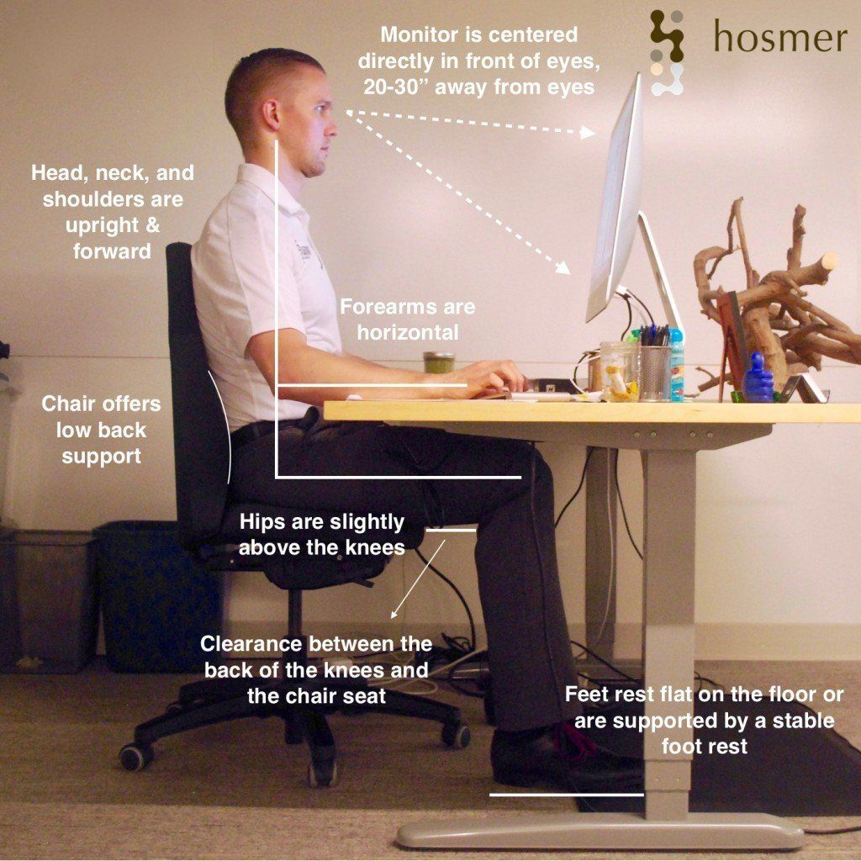
The perfect computer posture to prevent neck/shoulder and lower back pain
If using a laptop, invest in a stand to put it on (or use a ream of paper, your briefcase/bag or other object). This ensures the screen is as closely to eye level as possible.
For laptops used in the home, it is a good idea to buy a normal keyboard and mouse which makes it much easier to use the laptop in a more back friendly manner.
When on the move with your laptop, take time to check your bag or briefcase for items you will not need. It is amazing how much unwanted stuff quickly accumulates and the additional weight in your bag is extra weight that your shoulders and back have to bear.
Use a rucksack designed laptop case, carry it on both shoulders and adjust the straps so that the bag is held close to your back.
Don't use Laptop /Tablet on the train or Vehicles, If you are on the train and must use your laptop, don’t sit for long periods doing this, as you are looking down onto the screen with your head unsupported.
Using gadgets on your lap causes you pain as you hunch over to see the screen. Try to bring it up to eye level rather than holding you head in a forward position. A cushion or even a rolled-up jacket on your lap to rest elbows on usually does the trick.

Slide 6
Mental Health Status
Mental Health Status Analysis | Key Insights
From the Post-Pandemic Remote Work Health Impact 2025 dataset, here’s what the data shows across demographics:
By Age Group:
Adults: Higher rates of Anxiety
Youth: Higher rates of PTSD and Anxiety .
By Gender:
Female: Leading in ADHD, Anxiety, and PTSD.
Male: Higher rates of Depression and PTSD
By Work Arrangement:
Hybrid: ADHD & PTSD are most common
Remote: Anxiety & PTSD lead
Overall: PTSD appears as a common issue across all work modes

Slide 7

Mental Health Issues
Mental health conditions like stress, anxiety, PTSD, burnout, and depression can stem from a mix of individual, environmental, and work-related factors.
To mitigate these in the workplace, employers should focus on creating a supportive environment through organizational interventions, flexible work arrangements, and addressing psychosocial risks.
Root Causes:
Individual Factors:
Personal history, genetics, coping mechanisms, and pre-existing conditions can influence vulnerability.
Environmental Factors:
Traumatic events, financial instability, and major life changes can trigger or exacerbate these conditions.
Workplace Factors:
High workload, lack of control, poor communication, lack of support, and workplace violence can contribute to stress, burnout, and anxiety.

Slide 8
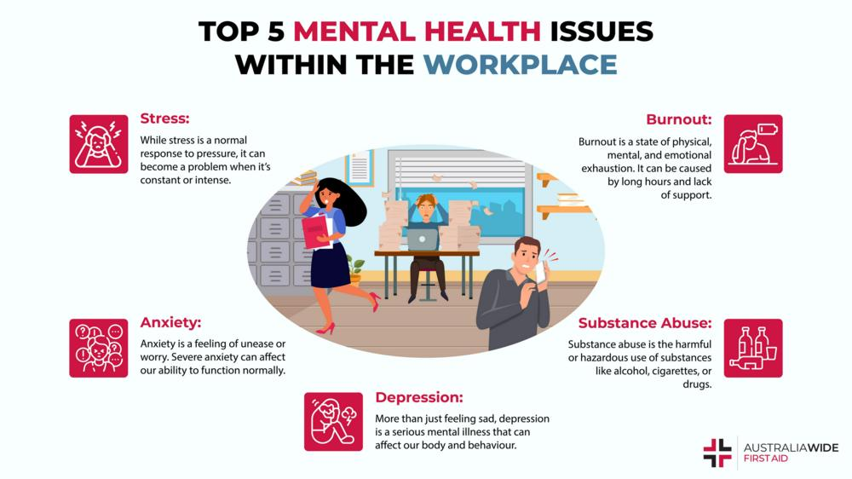
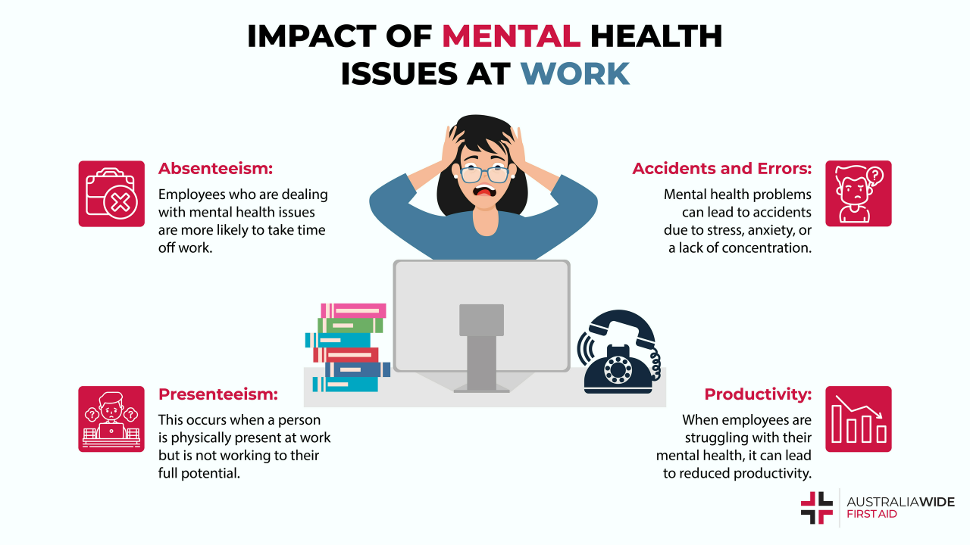
Mental Health Issues

Slide 9
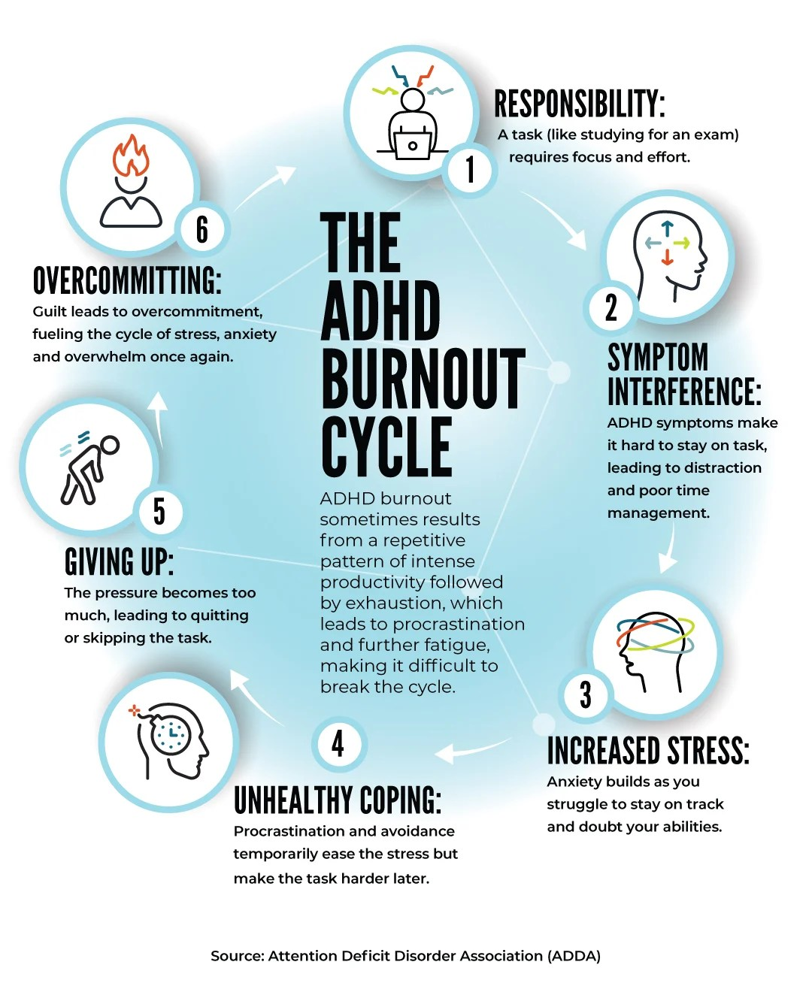
Reducing Mental Health Issues in the Workplace
Organizational Interventions:
Risk Assessment:
Regularly assess and address psychosocial risks in the workplace, such as workload management, communication, and work-life balance.
Flexible Work Arrangements:
Offer options like flexible hours, remote work, or compressed workweeks to improve work-life balance.
Open Communication:
Foster open communication channels where employees feel comfortable expressing concerns and seeking support.
Training and Education:
Provide training on stress management, mental health awareness, and available resources.
Support Systems: Offer employee assistance programs (EAPs) or other resources for mental health support.
Addressing Specific Conditions:
Burnout: Focus on workload management, clear communication, and opportunities for rest and recovery.
Anxiety and Depression: Provide access to therapy, medication, and support groups.
PTSD: Offer trauma-informed care, accommodations, and support for re-experiencing symptoms.
ADHD: Implement strategies for organization, time management, and focus.
Individual Strategies:
Stress Management Techniques: Encourage employees to practice stress-reducing activities like exercise, mindfulness, or deep breathing.
Healthy Lifestyle: Promote healthy habits like regular exercise, balanced diet, and sufficient sleep.
Seeking Support: Encourage employees to seek professional help when needed and normalize conversations about mental health.
Setting Boundaries: Help employees set boundaries between work and personal life to prevent burnout.
Building Resilience: Encourage employees to build resilience through positive coping strategies and social support
By implementing a combination of organizational and individual strategies, workplaces can create a more supportive and healthier environment, reducing the impact of mental health conditions on employees.

